Slide 1

Primitive Data Types
In PowerPoint, point at the speaker icon, then click the "Play" button.

Slide 2
Primitive Data Types
There are eight primitive data types in Java
Four of them represent integers:
byte, short, int, long
Two of them represent floating point numbers:
float, double
One character type: char
One boolean type: boolean
Their properties and differences are explained on following slides.
Click on slide to display successive lines

Slide 3

Numeric Primitive Data
The difference between the various integer primitive types is their size, and therefore the range of values that they can store:
Type
byte
short
int
long
Min Value
-128
-32,768
-2,147,483,648
< -9 x 10¹⁸
Max Value
127
32,767
2,147,483,647
> 9 x 10¹⁸
Commonly used type

Slide 4
Floating Point Types
For example,
Type
float
double
Min Value
+/- 3.4 x 10³⁸ with 7 significant digits
+/- 1.7 x 10³⁰⁸ with 15 significant digits
Max Value
Commonly used type
double score;
score = 78.4;

Slide 5
Characters
A char variable stores a single character.
Character literals are delimited by single quotes:
'a' 'X' '7' '$' ',' '\n'
Example declarations:
char topGrade = 'A';
char terminator = ';', separator = ' ';

Slide 6
Character Sets
A character set is an ordered list of characters, with each character corresponding to a unique number
A char variable in Java can store any character from the Unicode character set
The Unicode character set uses sixteen bits per character, allowing for 65,536 unique characters

Slide 7
Characters
uppercase letters
lowercase letters
punctuation
digits
special symbols
control characters
A, B, C, …
a, b, c, …
period, semi-colon, …
0, 1, 2, …
&, |, \, …
backspace, tab, ...
The ASCII character set is older and smaller than Unicode, but is still quite popular.
The ASCII characters are a subset of the Unicode character set, including:

Slide 8
Boolean
A boolean value represents a true or false condition.
The reserved words true and false are the only valid values for a boolean type
boolean done = false;
A boolean variable can also be used to represent any two states, such as a light bulb being on or off

Slide 9
Exercises
Declare an integer variable cardsInHand and initialize it to 13 .
Declare a double variable temperature and initialize it to 98.6 .
Try this for yourself. Answers on the next slide.

Slide 10
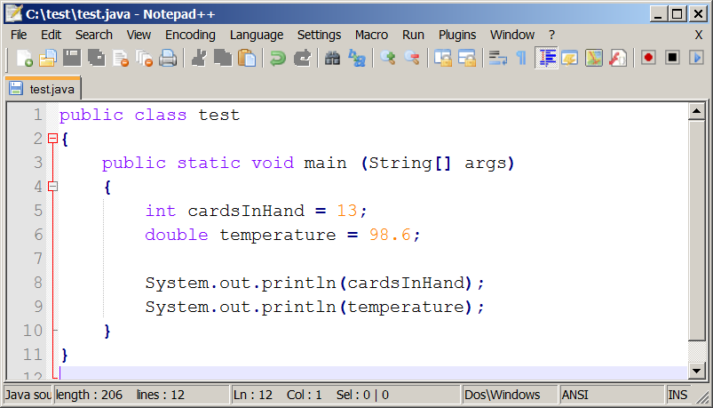
Exercise Answers

